Slide 1
Kids Care Room
For your children's event, our certified chaperones will coordinate activities and supervise the children. Based on the number of children defined, the costs include the necessary amount of chaperones at a ratio of 2:1 for infants, 5:1 for toddlers and 8:1 for ages 4 and up. Numbered cards will be issued to each parent at registration with coordinating wrist-bands for their children.
Professional Caregivers:
Are at least 18 years of age
Are certified in child/infant CPR and basic first aid
Have previous child care and/or teaching experience
Are thoroughly interviewed, screened, references are checked, and criminal background checks are performed
Will arrive at your children’s convention or party wearing our signature purple polo shirt with logo embroidered on the left side. They will also be wearing a name tag and identification badge
Security Measures: All children will receive a colored wristband upon entering the event. That wristband will contain the child’s name, age, and a security number. The parents will receive a security card that matches the number on their child’s wristband. The only person who may pick up that child is the card holder. We also require that anyone entering the room would leave alcoholic beverages outside of the Children’s Party.
Services Include:
Appropriate staff, registration, and security processes for children’s event.
Qualified First Aid and CPR certified activity coordinators
Age-appropriate toys, coloring sheets, arts and crafts, board games, group play, books, DVD Player, music, and much more for children's event.
Set-up, strike, & delivery; planning and supervision of the program
Applicable gratuities
Activities Include:
Age 6 Months – 3 Years: Blocks, Play Do, Coloring pages, Books for reading time, Cars with “Road” Rugs
Age 4 – 12 Years: Legos, Crafts such as Door Hangers, Fuse Beads/Bead Making, Sand Dollar Painting, Sand Bottle Art or “Message in a bottle” Activity
For all age groups:
For Valentines, the crafts will include making valentine cards for their parents and they will provide heart shaped candy as well.
Movies

Slide 2
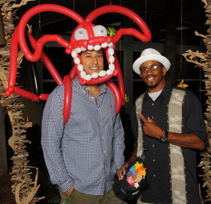
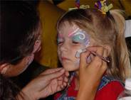
Additional Entertainment
A
B
Fun stuff for kids planned on Thursday’s and Friday’s evening Events:
Movie Night - Thursday
Face Painter – Thursday
Balloon Bender – Friday
More to come…….

Slide 3
Additional Information
STA FL must provide to Kids Night Out:
Register Kids Please!
List of all children attending the program including names and their ages.
Adequate room space (25 square feet per child) for children’s event adjacent to restroom facilities. Rooms for multiple children’s programs must be located together.
Kids Own Planned Food & beverage for each night.
Appropriate number of tables, chairs, pillows, blankets, cribs, water stations and garbage cans to accommodate group size.
Notes
Final guarantee for children attending is due 5 business days in advance of the event.

